Slide 1
Three-Way Data Binding
in Universal Apps
View
View Model
Cloud

Slide 2
HelloView
<TextBlock Text={Binding Greeting}/>
HelloViewModel
public string Greeting
{
get { return _greeting; }
set
{
_greeting = value;
RaisePropertyChanged(() => Greeting);
}
}

Slide 3
HelloView
<TextBlock Text={Binding Greeting}/>
EditView
<TextBox Text={Binding Name}/>
HelloViewModel
public string Greeting
{
get { return _greeting; }
set
{
_greeting = value;
RaisePropertyChanged(() => Greeting);
}
}
EditViewModel
public string Name
{
get { return _name; }
set
{
_name = value;
RaisePropertyChanged(() => Name);
}
}
Message Bus

Slide 4
MVVM
Where is it?

Slide 5
HelloView
<TextBlock Text={Binding Greeting}/>
EditView
<TextBox Text={Binding Name}/>
HelloViewModel
public string Greeting
{
get { return "Hello, " +_model.Name; }
}
EditViewModel
public string Name
{
get { return _model.Name; }
set { _model.Name = value; }
}
Person
public string Name
{
get { return _name.Value; }
set { _name.Value = value; }
}

Slide 6

Knockout
knockoutjs.com

Slide 7
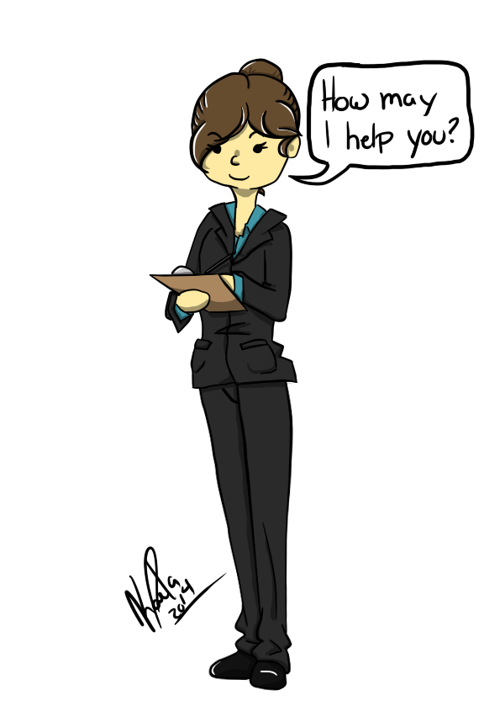
Assisticant
assisticant.net

Slide 8
Consistent

Slide 9
Inconsistent

Slide 10

Eventually Consistent

Slide 11
Conflict

Slide 12
Chess
e4 e5
Nf3 Nc6
Bb5 c6
Ba4

Slide 13
User’s Decisions
Card Deleted
Card ID
Card Created
Card ID
Card Text Changed
Text
Card Moved
From Column
To Column

Slide 14
Objects Affected
Card Deleted
Card ID
Card Created
Card ID
Board
Card Text Changed
Text
Card Moved
From Column
To Column

Slide 15
Objects Affected
Card
Board
Card Created
Card ID
Card Text Changed
Text
Card Deleted
Card ID
Card Moved
From Column
To Column

Slide 16
Objects Affected
Card
Board
Card Text Changed
Text
Card Moved
From Column
To Column
Card Created
Card ID
Card Text Changed
Text
Card Moved
From Column
To Column
Card Deleted
Card ID

Slide 17
Objects Affected
Card
Board
Card Text Changed
Text
Card Moved
Column
Card Created
Card ID
Card Text Changed
Text
Card Moved
Column
Card Deleted
Card ID

Slide 18
Conflicts
Card Moved
Column
Card Moved
Column
Card Moved
Column

Slide 19
Conflict Resolution
Card Moved
Column
Card Moved
Column
Card Moved
Column
Card Moved
Column

Slide 20
Historical Model
Card
Board
Card Text Changed
Text
Card Moved
Column
Card Created
Card ID
Card Deleted
Card ID

Slide 21

Firebase
firebase.com

Slide 22

Correspondence
correspondencecloud.com

Slide 23
Thank You
bit.ly/3waydatabinding
@michaellperry
me@michaelperry.net
qedcode.com
assisticant.net
correspondencecloud.com

